Slide 1

Wearables: Overview
JSM 2019

Slide 2
Overview of this course:
Data and Code
Wearables: overview
Functional PCA
Scalar on Function Regression
Function on Scalar Regression
Other Functional Approaches
Non-functional methods

Slide 3
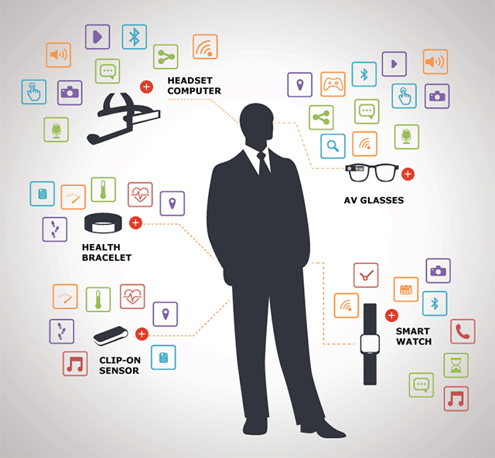
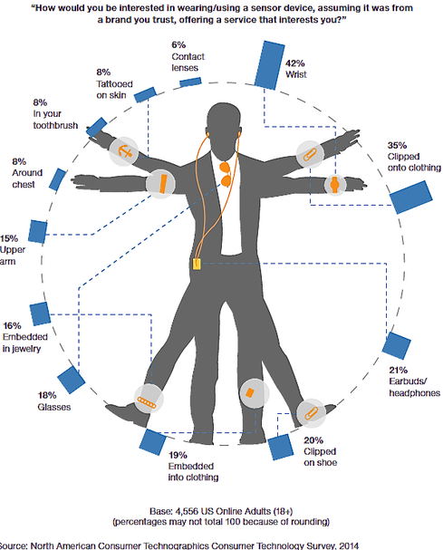
Wearables

Slide 4
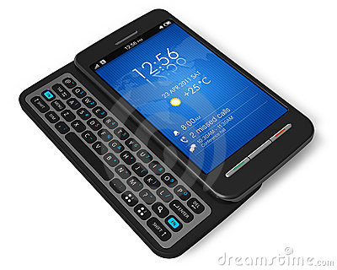
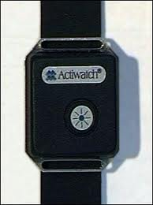
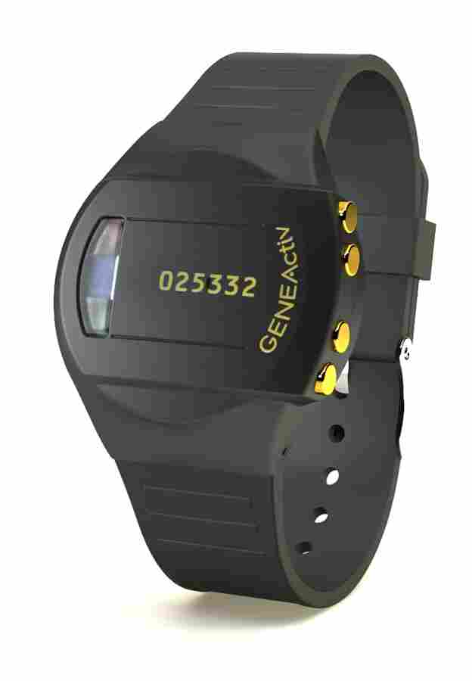
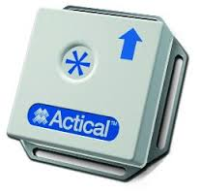
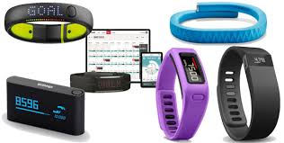
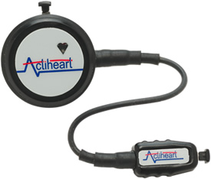
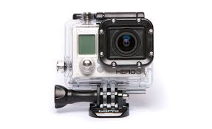
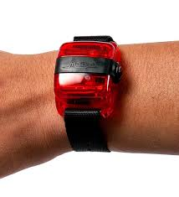
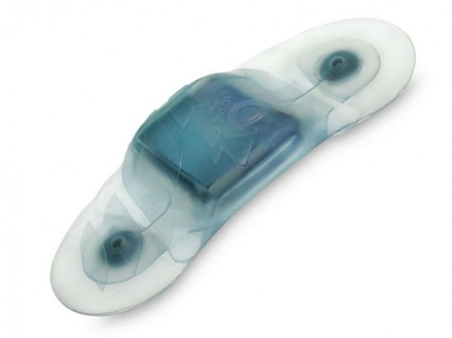
Wearables
Research
Consumer

Slide 5
What do wearables offer?
Physical Activity
Steps or Activity Counts
Steps and Gait (temporal asymmetry, stride variability)
Energy Expenditure (calories, …)
Sleep
Circadian Rhythmicity
Electronic Diary/Ecological Momentary Assessment (1-2-4 per day)
Heart Rate (ECG, bpm)
Blood Glucose Monitoring
Light, Temperature (Circardian markers)
Voice (Mood, Progression of Disease)

Slide 6
Clinical applications
Aging (BLSA, Health ABC, NHANES, UKBiobank, WHI)
Dementia and AD (Sleep & Agitation)
Cardiovascular: CHF, Afib, and post-surgery
Multiple Sclerosis (Disability & Sleep)
Mood Disorders
Cancer: Fatigue and Sleep
Diabetes (T2)
Diabetes in babies (Nurture)
Rehabilitation (METRC)

Slide 7
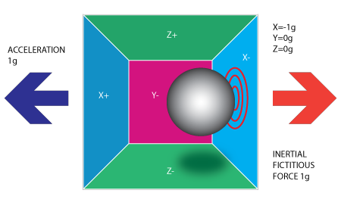
Accelerometers
Use sensors to detect accelerations in one-to-three orthogonal planes
Small sensor, non-invasive measurement
Long battery life (tiny energy consumption)
Inexpensive: ~$10 if you want to build your own device

Slide 8
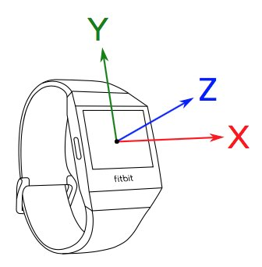
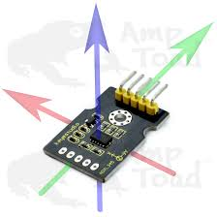
Accelerometers
Detects acceleration in three orthogonal planes
https://www.youtube.com/watch?v=irjG9Y4NGnE

Slide 9
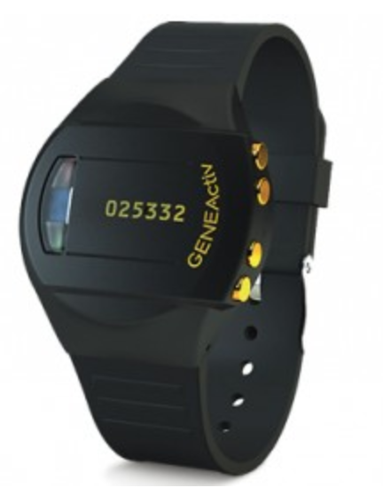
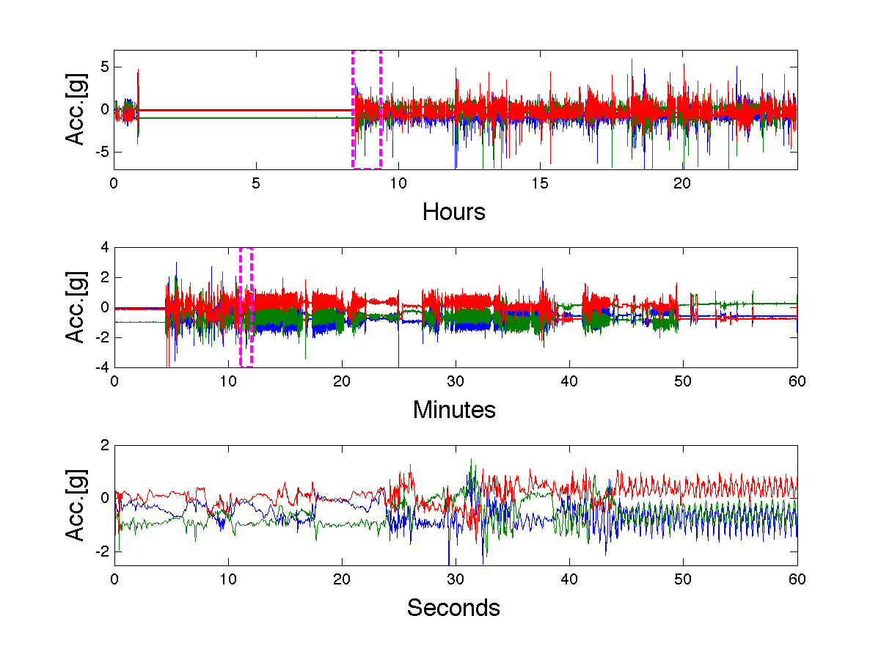
Data
50.4
Activity Count

Slide 10
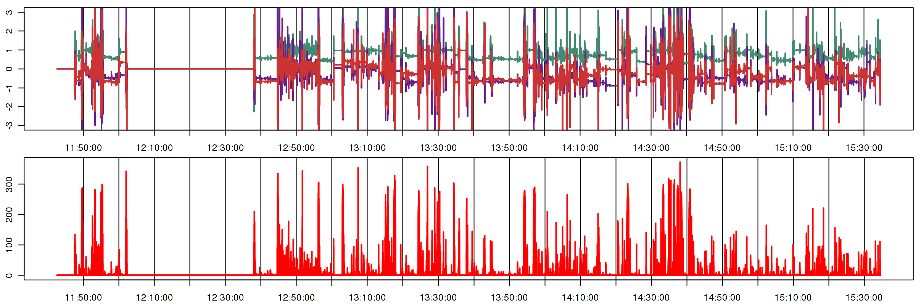
Raw (Hz) vs Activity Counts (minute)
Top: raw accelerometry data at 80Hz
Bottom: Activity Count at minute level

Slide 11
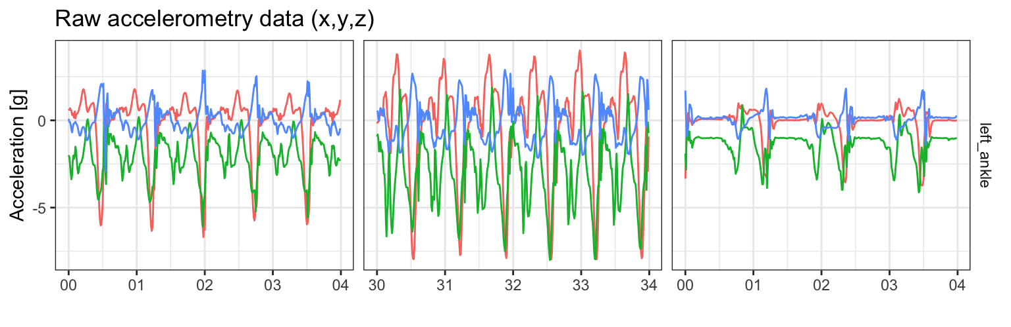
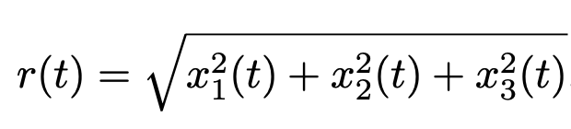
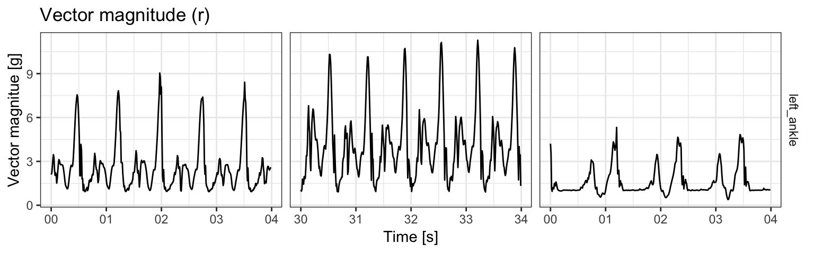
Subsecond-level accelerometry data analysis
Vector Magnitude (VM): 1-dimensional summary of 3-dimensional time-series
Running
Running fast
Walking

Slide 13
Stage 1: Episode Detection
Non-wear time
Posture: sitting, lying, standing, driving, stairs climbing, …
Activity: walking, running, driving, …
Sleep: rest/wake, in/out of bed, …

Slide 14
Stage 2: Feature extraction
Walking: cadence, stride-variability, asymmetry, …
Sleeping: time in bed, fragmentation, variability, …

Slide 15
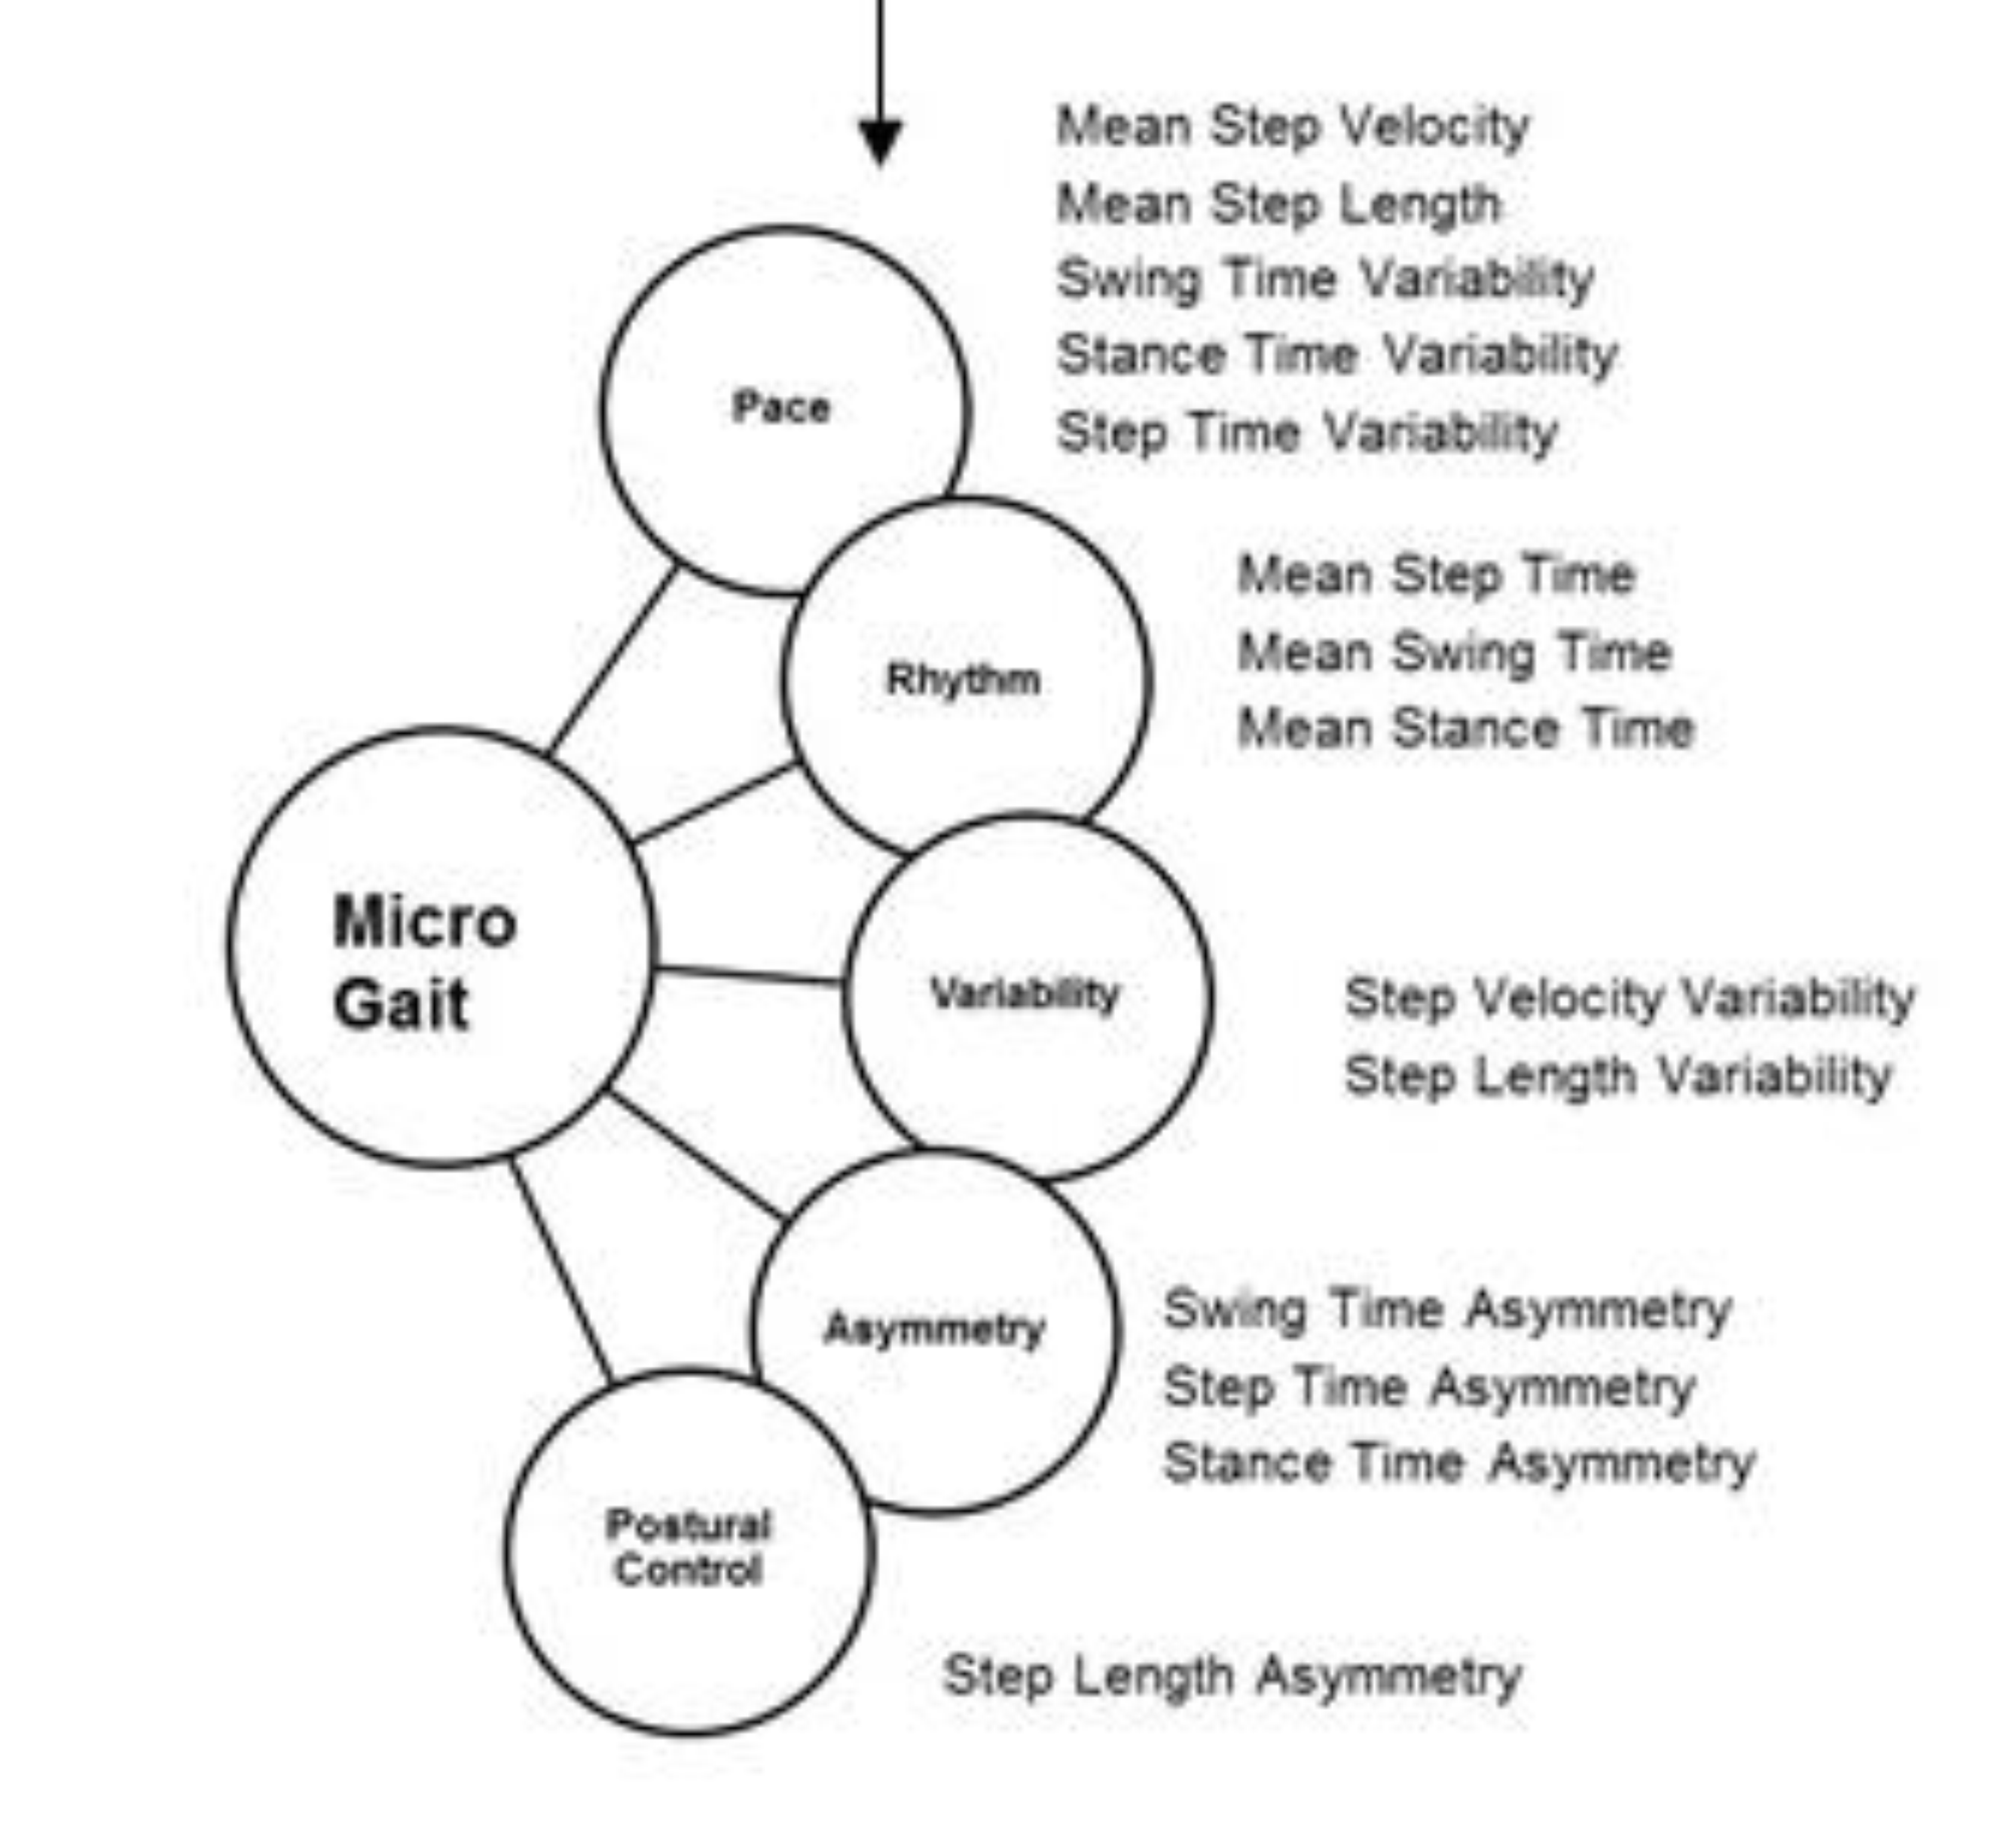
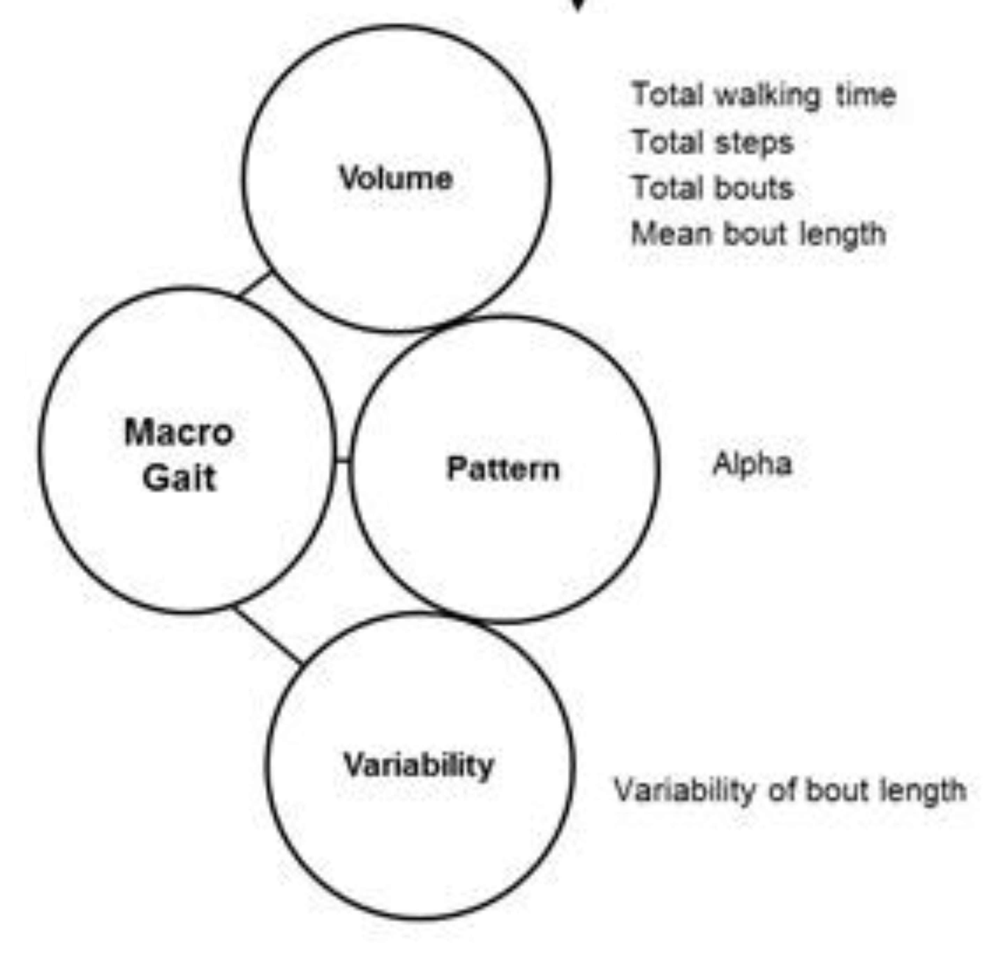
Stage 3: Feature Grouping
Example: grouping of gait characteristics
Gait in Mild Alzheimer's Disease.
Feasibility of Multi-Center Measurement
in the Clinic and Home with Body-Worn Sensors.
A Pilot Study, Zetterberg et al, 2019, JAD
Notes:
Split into two; It should fluctuate around certain zero level; show those examples in the non-event group

Slide 16
Challenges

Slide 17
Sensors fusion

Slide 18

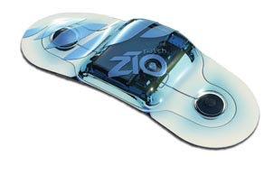
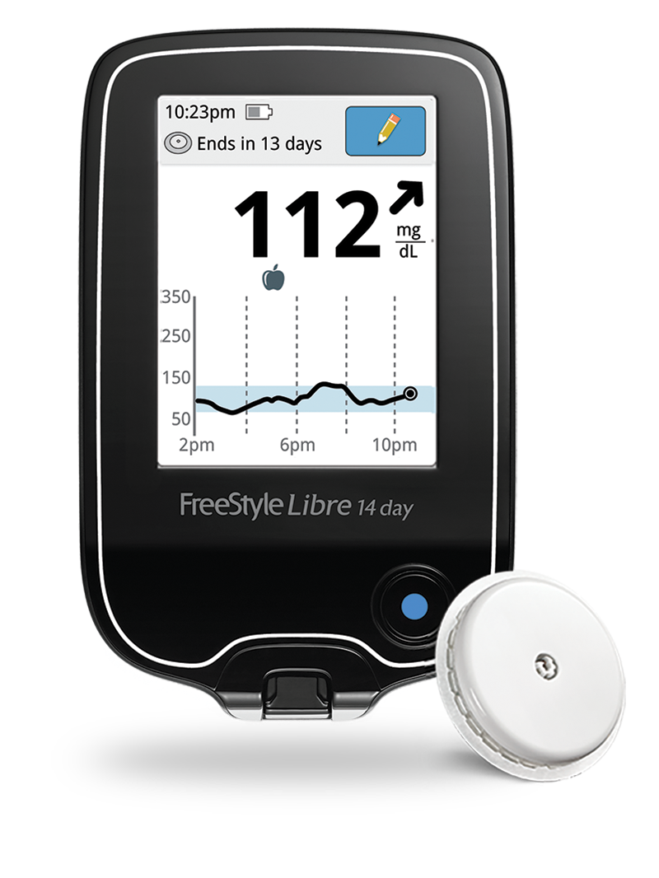
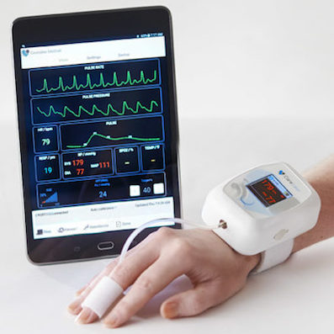
Functional Methods
Physical activity trackers
Heart rate monitors
Blood glucose monitors
Blood pressure monitors
All devices record signal over 24 hour periods – the exact focus of Functional Data Analysis (FDA).

